Slide 1

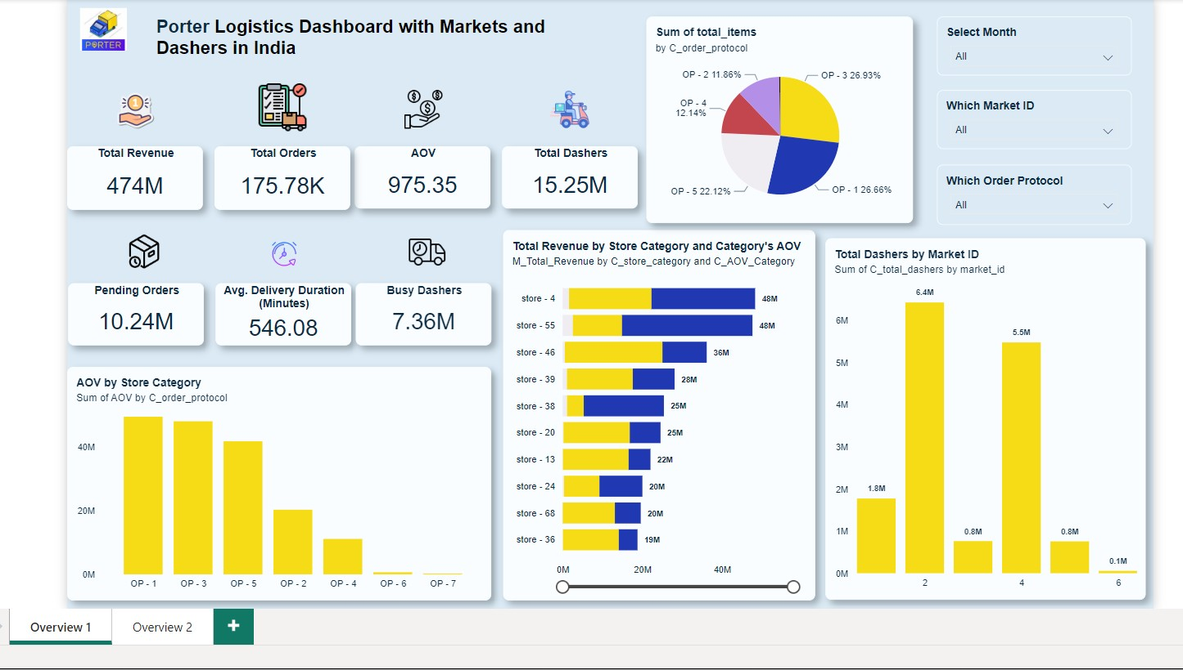

Slide 2
TWO IDEAS
The total revenue for January and February 2015 reached an impressive ₹474 million. In January, the revenue was ₹167 million, while February saw a significant increase to ₹307 million.
During this period, the total number of orders amounted to 61,840 in January and increased to 113,940 in February, indicating a strong upward trend in customer demand.
The average order value remained consistent at ₹975 for both months, reflecting stable purchasing behavior among customers.
Among the product offerings, OP-1 and OP-3 stood out with the highest average order values, indicating their popularity and potential for further promotion.
Store-4 and Store-55 achieved the highest total revenue, each generating ₹96 million, showcasing their effectiveness in driving sales.
Market IDs 2 and 4 reported the highest number of dashers, totaling 12 million, which highlights the importance of effective delivery logistics in meeting customer expectations.
The average delivery duration is currently at 546.08 minutes, equivalent to approximately 9 hours.

Slide 3
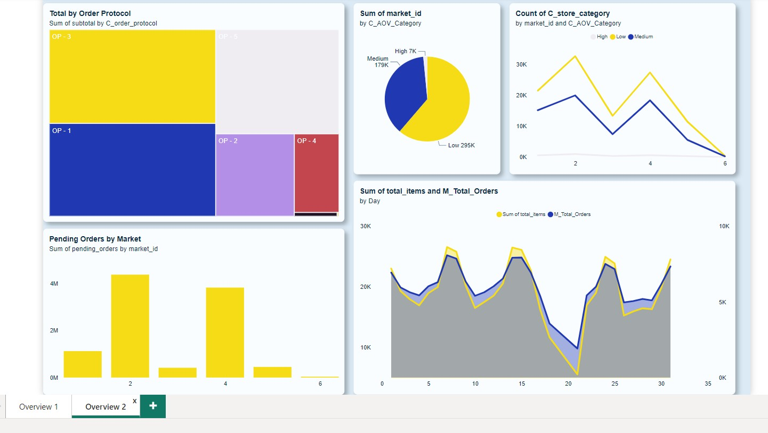

Slide 4
Insight
OP-3 has made the largest subtotal contribution, totaling ₹137 million, indicating its significant impact on overall revenue. Conversely, OP-7 has the smallest subtotal contribution at ₹57,000, suggesting that it may require further analysis to understand its performance.
There is a notable increase in pending orders within Market ID 2 and Market ID 4, which may indicate potential operational challenges or customer dissatisfaction that need to be addressed promptly.
The markets have been segmented into high, medium, and low average order value (AOV) categories, with the "Low AOV" category dominating by 62%.
The third week of both months has experienced a slight decline in total orders.

